Slide 1

Full stack development with JavaScript
Instructors
Miss. Amrita Das
Mr. Haseeb Iqbal

Slide 2
What is Full stack development?
Front End (Client Side)
HTML
CSS & Bootstrap
JQuery
Back end (Server Side)
Framework (Express.js)
Database (MySQL/Mongo DB)
Socket Communication (Socket.io)

Slide 3
Tools and Technologies
Tools
IDE (Web Strom)
Free Student license
MySQL (PhpMyAdmin, freemysqlhosting.net)
Node.JS
Technology / Libraries
Express.JS
Socket.io
MySQL
Bootstrap (less)
Jquery

Slide 4
Course Breakdown
Day One
Introduction to Technologies
Inventory Management
Create Products
Retrieve Products
Lunch Break 45 minutes
Lab 1
Day Two
Q & A on Day 1
Inventory Management
Update Products
Delete Products
Introduction to Meteor
Multiuser real-time communication
Lunch Break
Lab 2

Slide 5
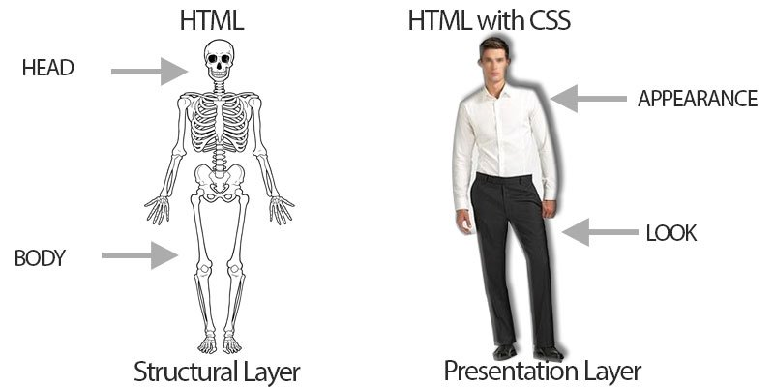
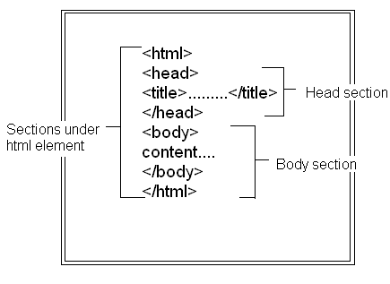
HTML

Slide 6
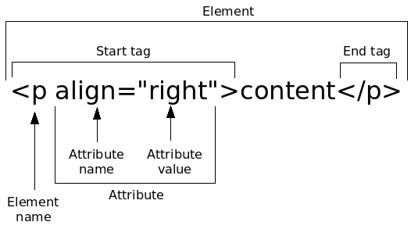
HTML cont.

Slide 7
CSS

Slide 8
CSS cont.
Selector
p {
color : red ;
property property value
}
Declaration

Slide 9
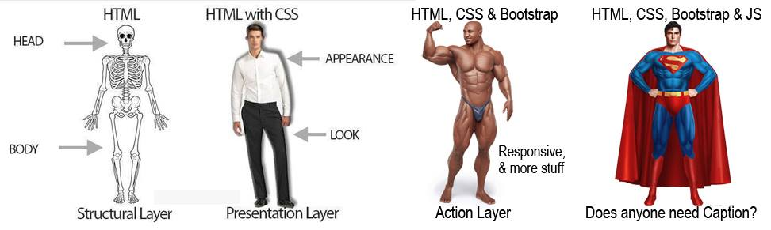
Bootstrap

Slide 10
Bootstrap cont.

Slide 11
Bootstrap cont.

Slide 12
JavaScript & JQuery

Slide 13
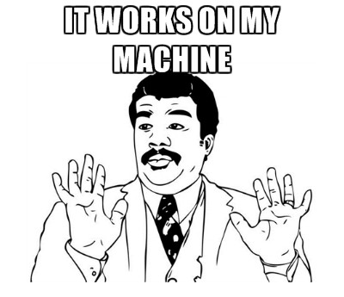


Why JQuery?

Slide 14
HTML, CSS, and JavaScript are just Nouns, Adjectives, and Verbs
[Andy Tiffany]

Slide 15
Why server side JS?

Slide 16
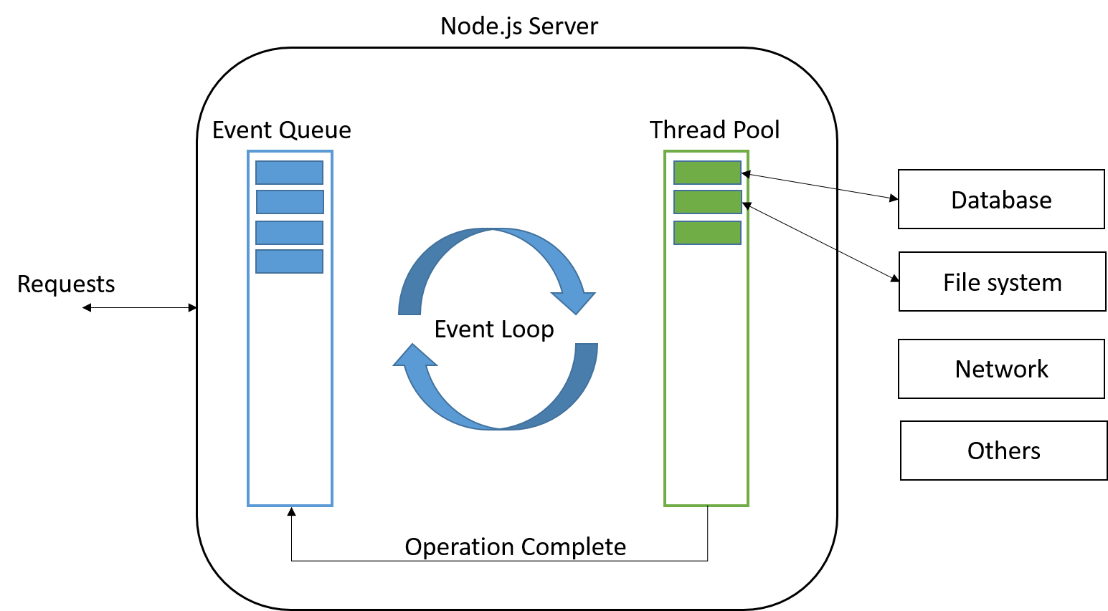
Node.JS Control Flow

Slide 17
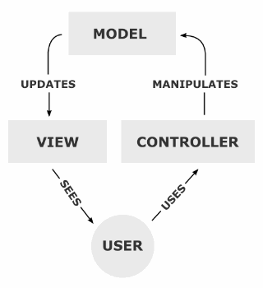
Node JS / Express.js
One language for client and server
Express JS
MVC
Directory Structure
Package.json
App.js
Routes
Models
Views
Public
URL Rewriting

Slide 18
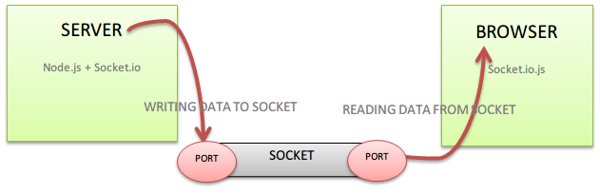
Socket Programming
HTTP
Ajax
Socket.io

Slide 19
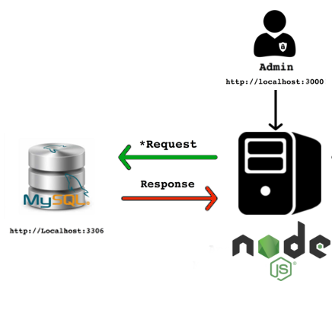
Database
DB Design
Choose a DBMS (MySQL)
DB Communication in Model (MVC)

Slide 20
Further Questions?

Slide 21
Inventory Management
Login
Create
Select

Slide 22
Further Questions?

Slide 23
Lab 2
Inventory Management
Login
Create
Select
Delete
Update

Slide 24
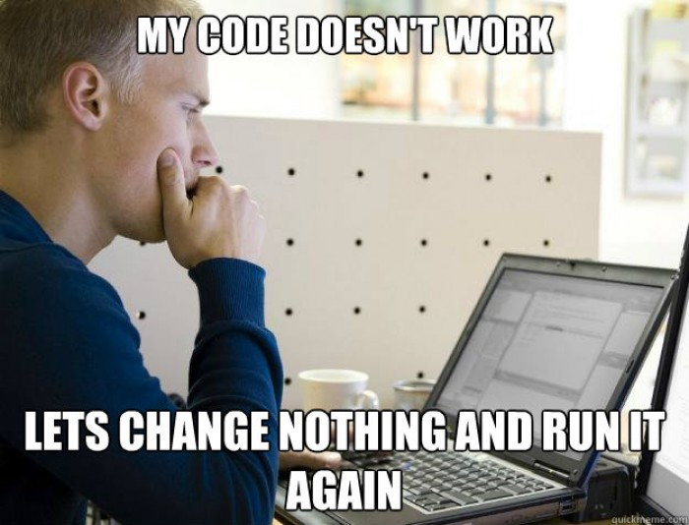

Slide 25
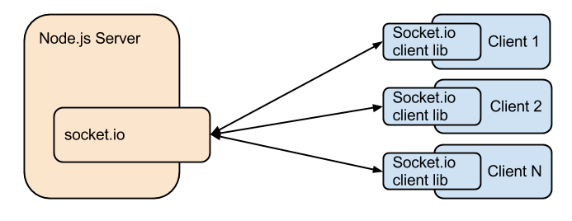
Multi User Real-time communication

Slide 26

Introduction to Meteor

Slide 27
Further Questions?

Slide 28
Thank you ☺
adamritadas@gmail.com
Haseeb.iqbal@student.fh-kiel.de

